Slide 1
Creating immersive VR product experiences with KeyVR
June 27th, 2019
Dries Vervoort

Slide 2
Before we begin...
This session will be recorded
Slideshow PDF will be available
KSPs will be available
Computer: Dual Intel Xeon CPU E5-2630 v3 (32 Threads), 32 GB RAM, NVIDIA GeForce RTX 2080, Windows 10 Pro
VR Headset: HTC Vive with 2 Controllers
If you have questions, just ask

Slide 3
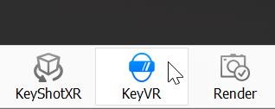

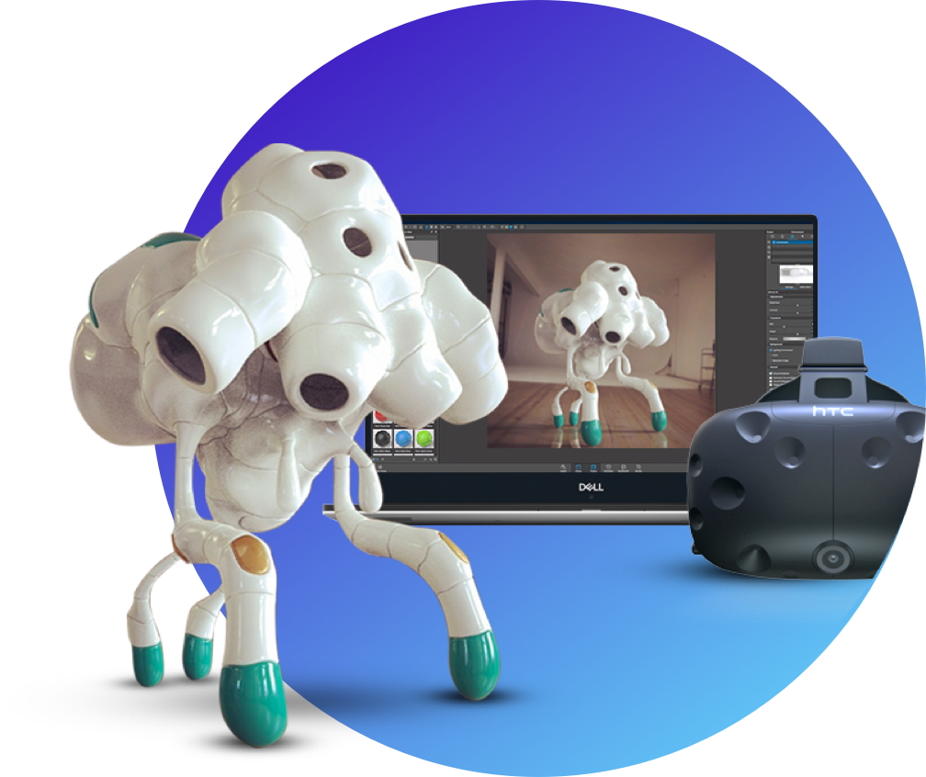

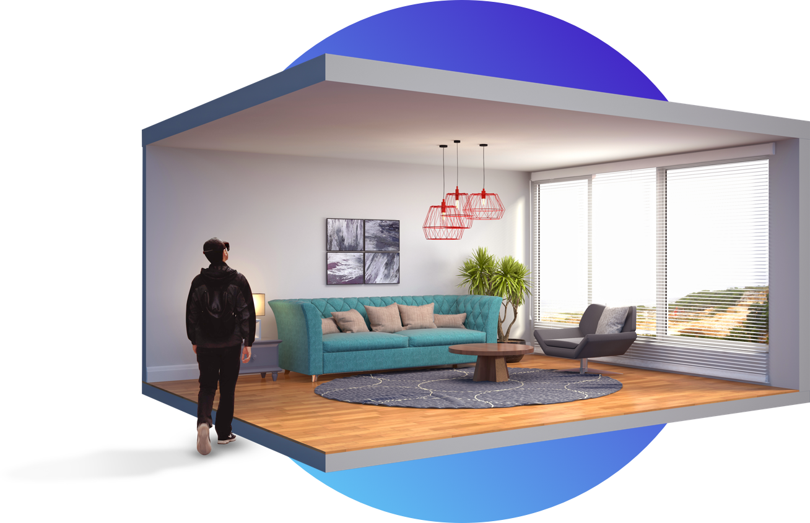
What is KeyVR?
A completely new VR experience application created by Luxion
Leverages existing KeyShot scene data
Easy setup and preparation
Transports the user into a KeyShot scene with one click
Launched from KeyShot or used independently

Slide 4
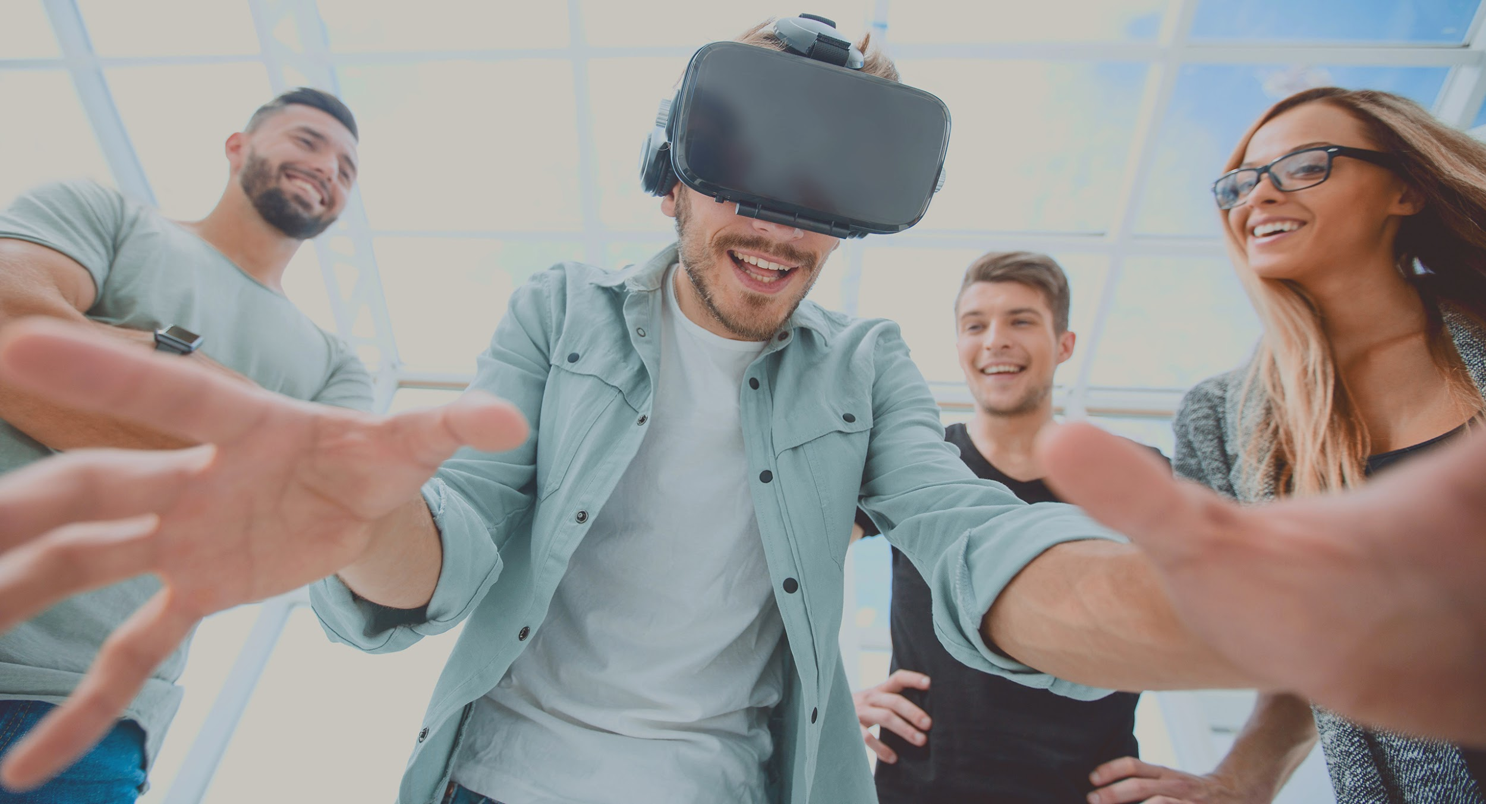
Why VR?
Real-time interactive experience
Immersion in design and environments
True sense of scale
Sense of exploration
Tangible interaction with models, materials and animations
Quick design decisions

Slide 5
In this webinar
Recommended hardware requirements
Building blocks of a KeyVR experience
Setting up scenes for KeyVR
Workflows for optimal model structure and materials
Best practices for optimal scene interactivity
Harness Physics
Demonstration
Q&A

Slide 6

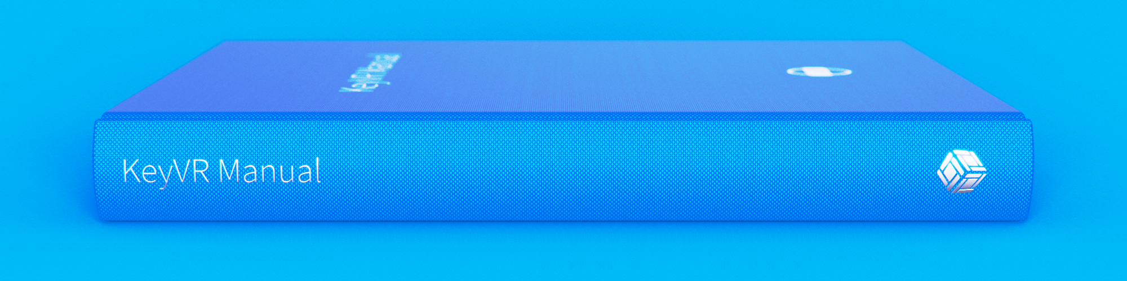

KeyVR Manual - The KeyVR first aid kit
https://luxion.atlassian.net/wiki/spaces/KVR/overview
Hardware and OS requirements
Current and up-to-date capabilities and limitations
Getting Started guide
Detailed changelog

Slide 7
Recommended hardware requirements

Slide 8
A few words on OS support...
Running KeyVR requires Windows
Supported OS
  Windows 7
  Windows 10

Slide 9
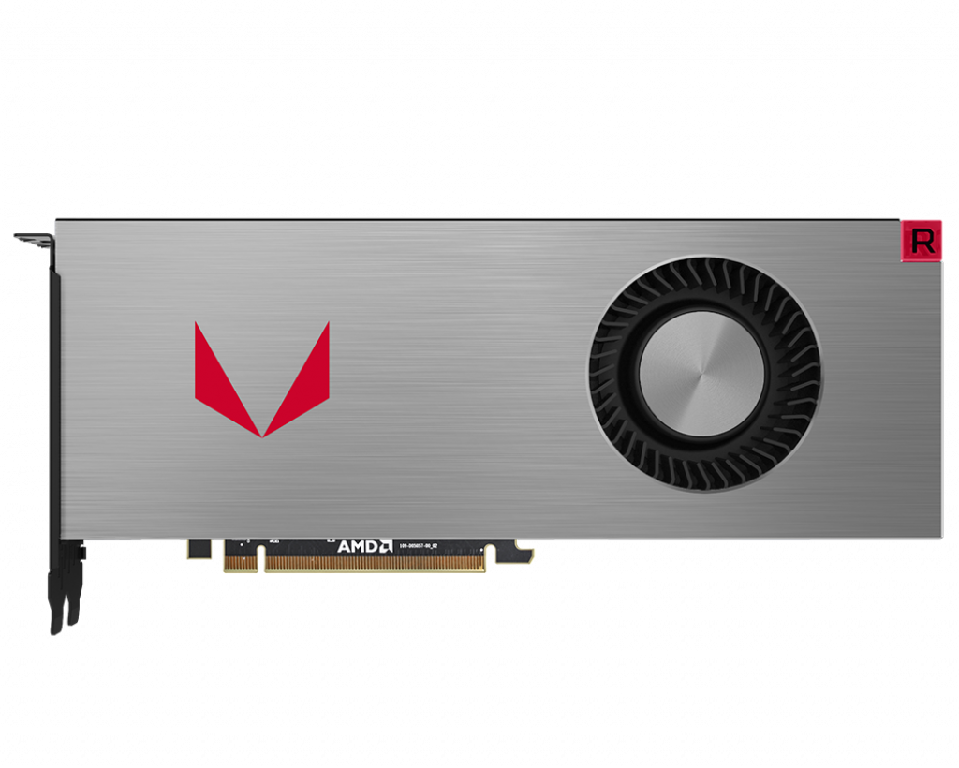
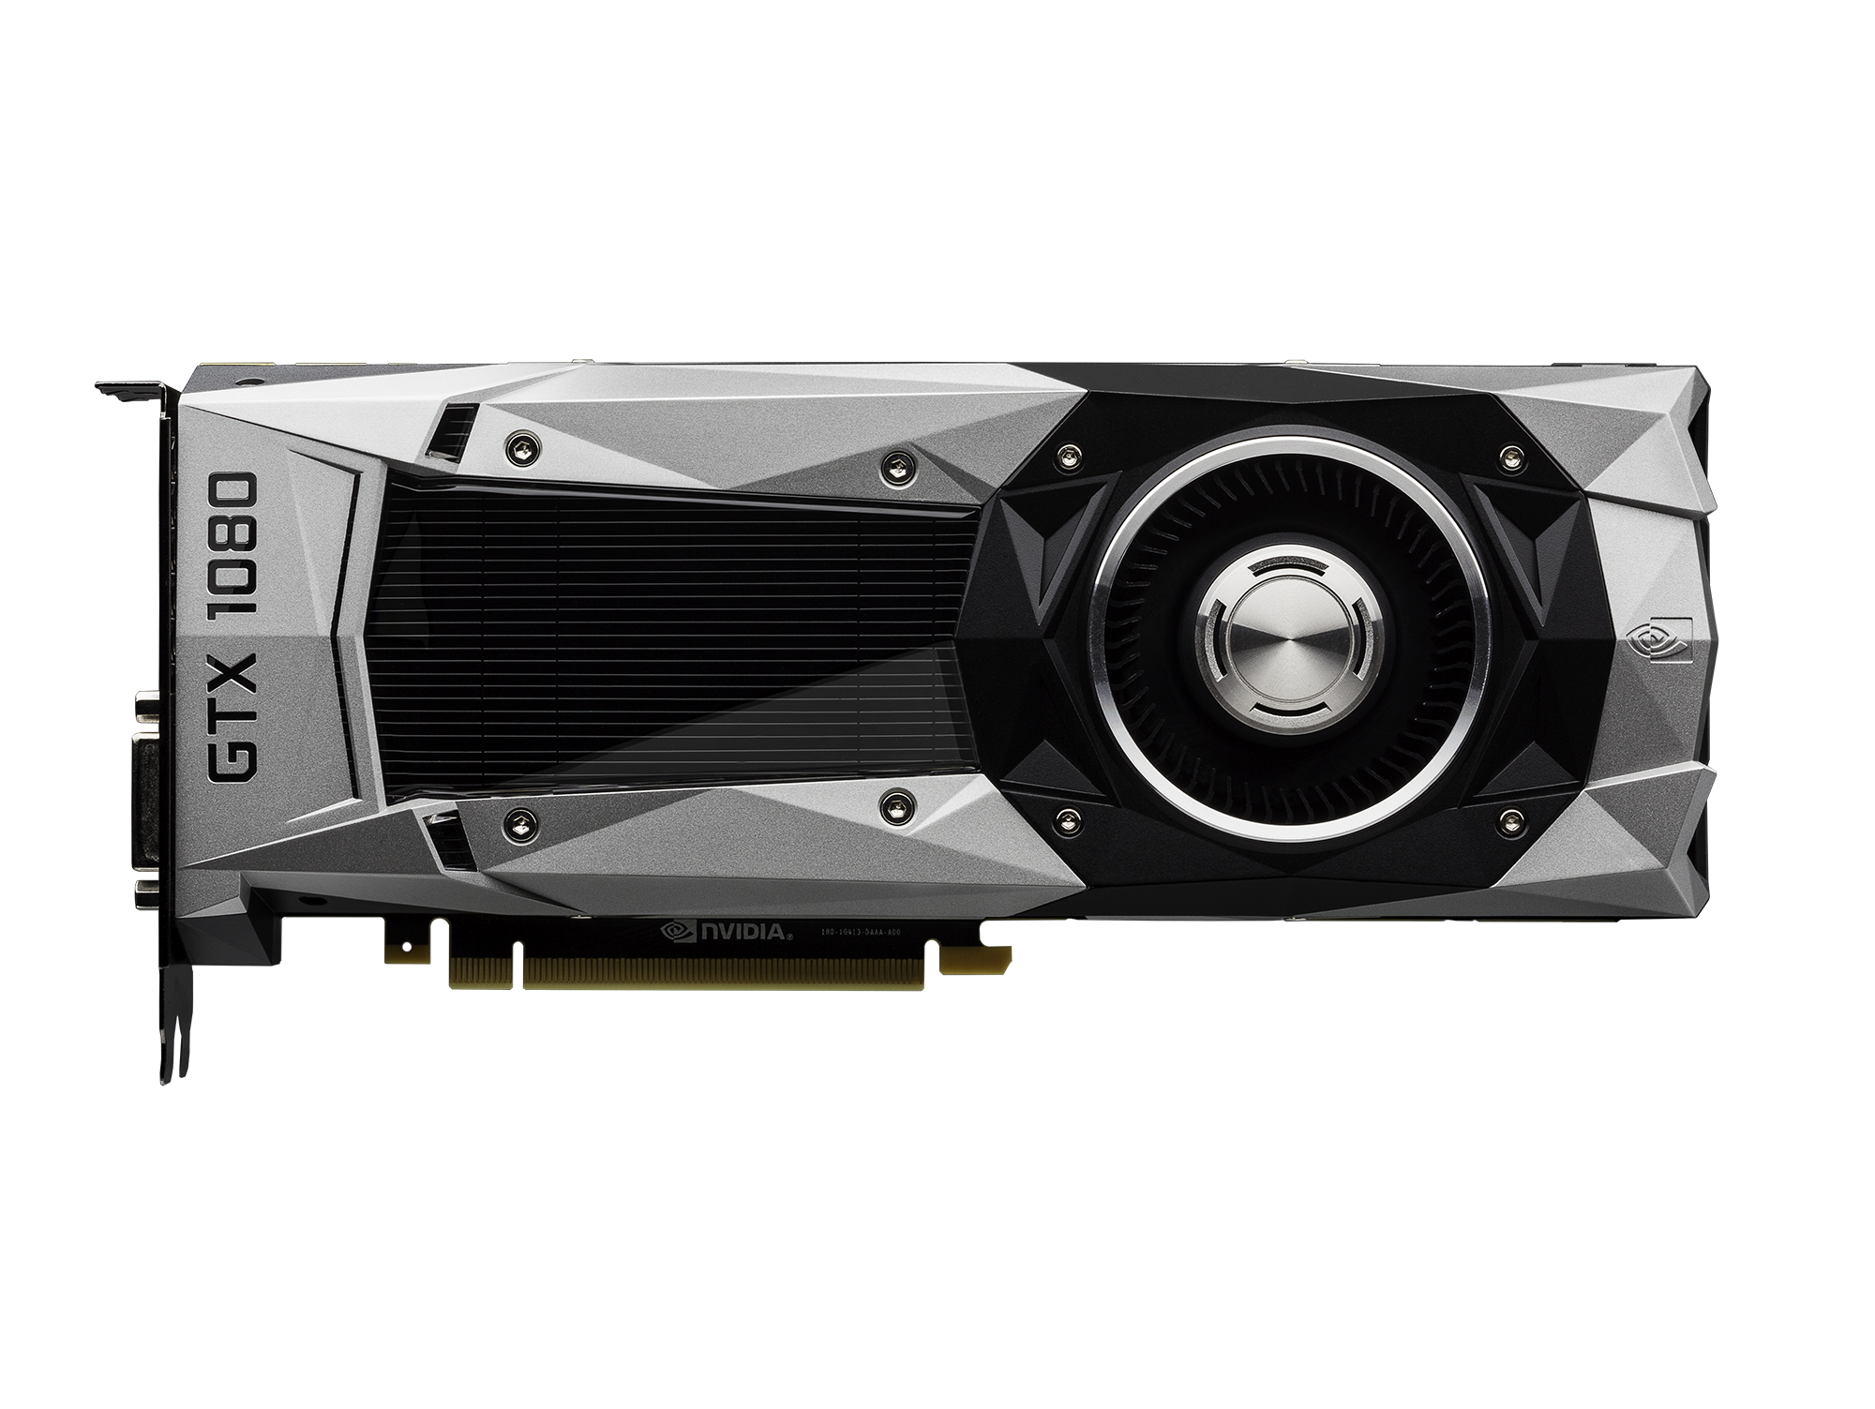
Supported GPUs
Recent NVIDIA or AMD graphics card
NVIDIA GTX 1080 or AMD Vega 64 (or newer) for optimal performance
  Processing power for complex models (minimum 90 fps for headset)
  8 GB memory to fit models, textures, HDRIs
NVIDIA GTX 1080
AMD Vega 64

Slide 10
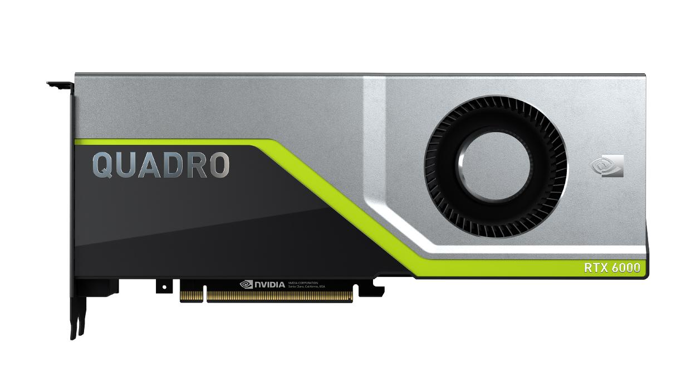

Worried about running out of GPU memory?
NVIDIA Quadro graphics cards are officially recommended by Luxion
Main benefit of Quadro over GeForce is large memory capacity
  QUADRO RTX 8000: 48 GB
  QUADRO RTX 6000: 24 GB
  QUADRO RTX 5000: 16 GB
Ease of mind: Cards can fit vast amounts of geometry and textures
note: RT (raytracing) and Tensor Cores of Turing RTX cards are currently not leveraged by KeyVR

Slide 11
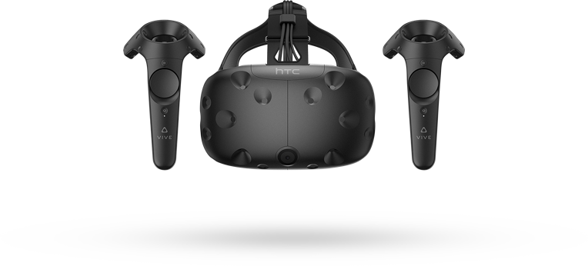
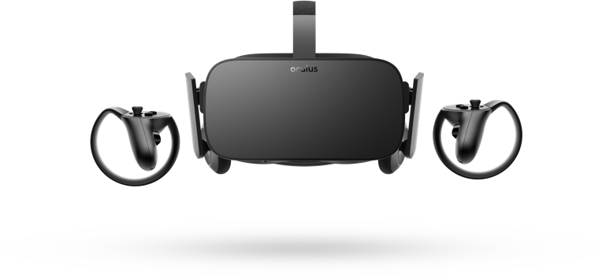
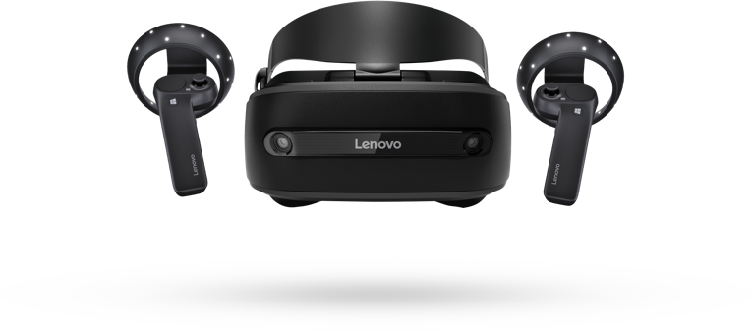
Supported headsets
HTC Vive, Windows Mixed Reality, Oculus Rift and Oculus Rift S
  Oculus Rift through Oculus Desktop
  HTC Vive or Windows Mixed Reality through SteamVR
Recommendation for stationary use: HTC Vive
  Great display quality, controllers and comfort
Recommendation for nomadic use: Oculus Rift S
  Compact, inside-out tracking, low cost

Slide 12
NOT Supported headsets
All-in-one standalone VR headsets (no PC connected = not enough horsepower)
  Oculus Go
  Oculus Quest

Slide 13
Building blocks of a KeyVR experience

Slide 14




The KeyShot building blocks
Models
Materials
Environments
Cameras

Slide 15
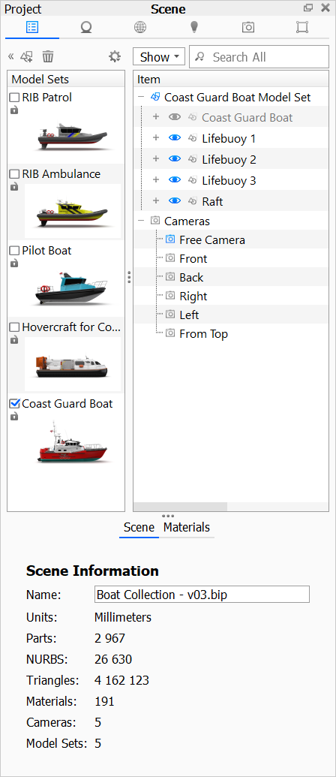
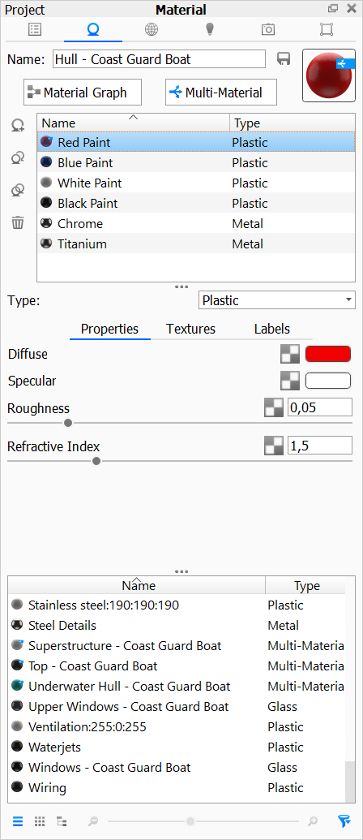
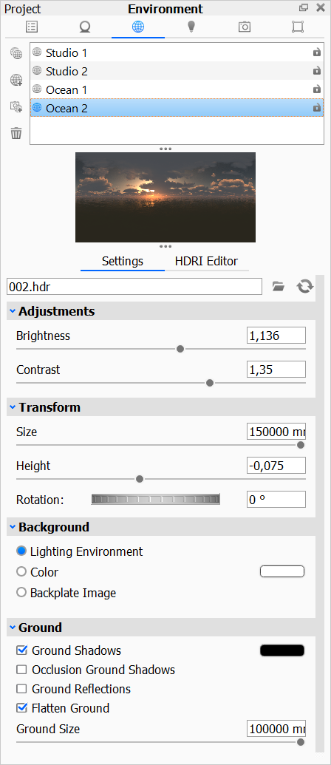
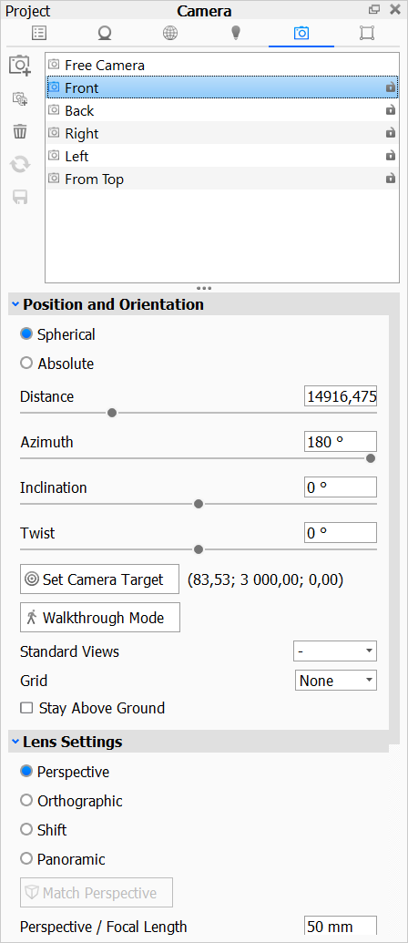
Switching between variations
Model Sets
Multi-Materials
Environment list
Camera list

Slide 16


Moving Models
Model Animations as set up in KeyShot
Models can be grabbed, moved and manipulated with physics
  Gravity and collision detection

Slide 17
Setting up scenes for KeyVR and the importance of 1:1 model scale

Slide 18
It’s the model scale, stupid
Make sure all models have accurate sizes
In KeyShot, you can ‘cheat’ by adjusting the dolly distance and focal length
  This does not work in VR!
  Tiny objects will always look tiny in VR
  Only way to make objects appear larger is by scaling them up

Slide 19
Workflows for optimal model structure and tessellation, and materials

Slide 20
Model setup
Triangle count is paramount!
  Performance degrades with higher triangle counts
  More memory does not help with performance, but allows for loading larger models and textures
CAD models: Import NURBS!
  Control tessellation on import
  Use Re-Tessellate to control the tessellation of NURBS models in the scene
Unlock models to move them / Lock models to fix them in space
  On the model level (directly below Model Sets)
  All models that are not locked can be moved

Slide 21
Material setup
KeyVR Manual - The KeyVR first aid kit
Have a good look at the KeyVR Capabilities page in the manual
  Up-to-date overview of shading and material capabilities
  Capabilities are continuously improved, so make sure to revisit the page after updates or a new release!

Slide 22
Best practices for optimal scene interactivity in KeyVR

Slide 23
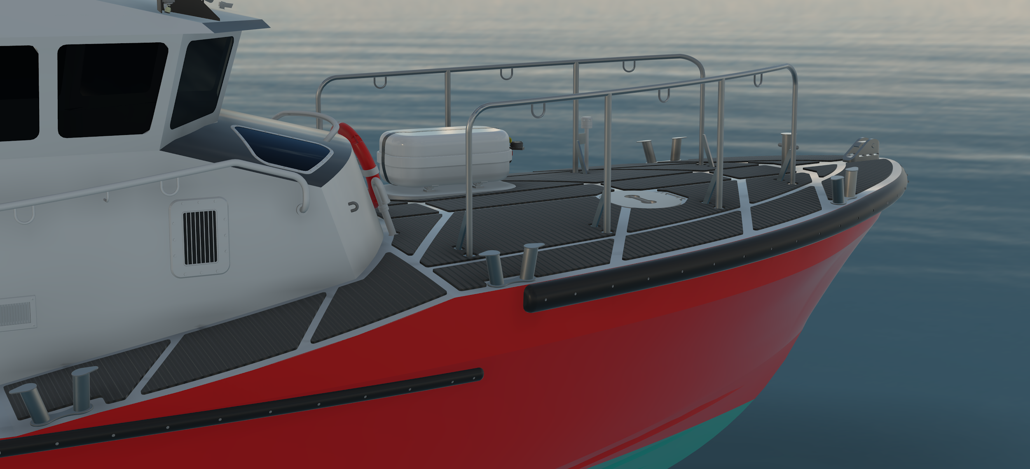


Targeting geometry with the controller
Moving models and switching materials requires targeting geometry
Avoid small model features that are too hard to hit when aiming with the controller

Slide 24
Harness Physics to increase user engagement when manipulating models

Slide 25
How do the physics in KeyVR work?
Simulates gravity and collision
On the model level (directly below Model Sets)
All top-level models that are not locked can be manipulated
Models can still collide with locked models
Enabled by a single ‘Physics’ toggle button
  ‘Gravity’ slider to control strength of effect

Slide 26
Best practices for physics
KISS (not the band)
Limit number of objects that can be moved
  The physics are optimized for interactions between a handful of models
  So don’t try...
    Building a VR Jenga tower
    Building a VR marble machine
Avoid very thin geometry
  Thin geometry can cause odd protrusions and glitchy collisions
  Ground plane geometry is not needed
    Objects already interact with the default ground

Slide 27
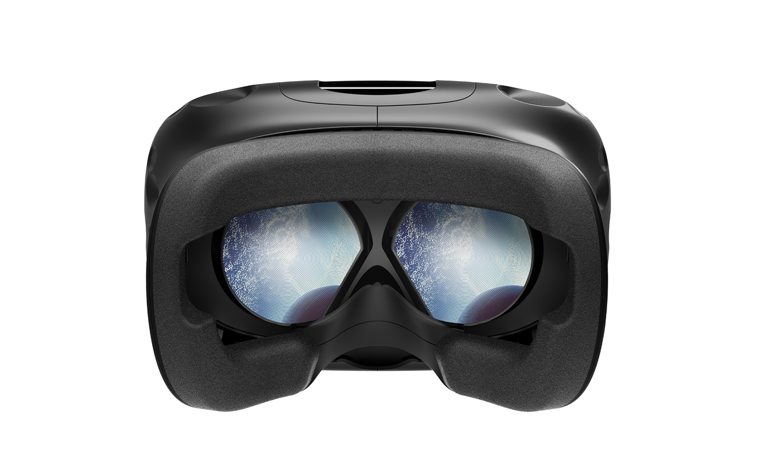
Demo time!

Slide 28
Questions?

Slide 29
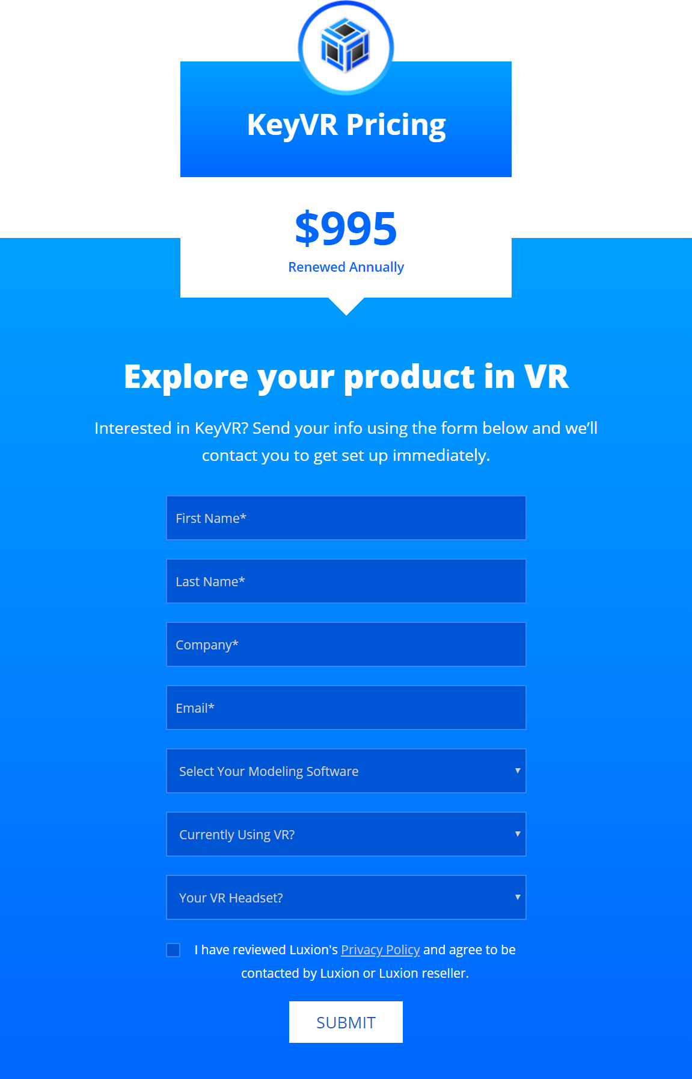
Not a KeyVR user yet, but interested?
Request your trial on the KeyVR website
https://www.keyshot.com/keyvr/

